Slide 1
KALPANA RANGRA
SCRUM AND AGILE

Slide 2

“Agile software development refers to software development methodologies centered round the idea of iterative development, where requirements and solutions evolve through collaboration between self-organizing cross-functional teams.”

Slide 3
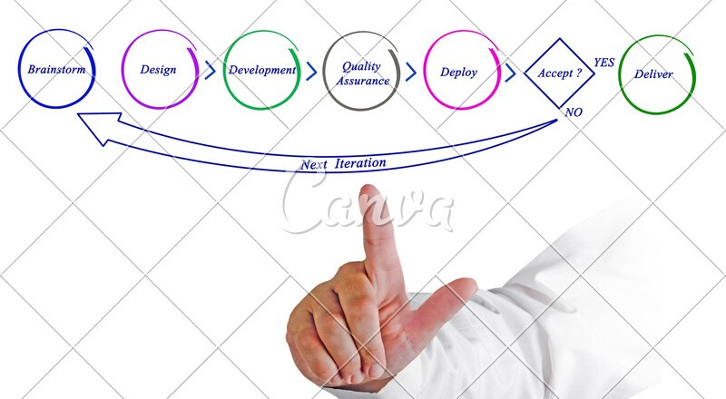

Slide 4
Agile
Suggests shorter iterations
Enables change in priorities from iteration to iteration.
According to the customer’s requirements
There is room for the addition of new features in the next iteration, without having any dependency on the previous iteration.
Agile views change as a means for improvement and believes that a change adds value to the product.

Slide 5

Manifesto
“Individuals and interactions over processes and tools.
Working software over comprehensive documentation.
Customer collaboration over contract negotiation.
Responding to change over following a plan.”
“That is, while there is value in the items on the right, we value the items on the left more.”le bit of body text

Slide 6


Slide 7

Most popular and widely used frameworks to implement Agile in industry projects.
It is used synonymously with Agile, but in reality they are different.
Scrum is a framework used for incremental product development by deploying one or more cross functional, self-organizing teams.
Using scrum, product development is carried out in small, fixed-length iterations, sprints.

Slide 8

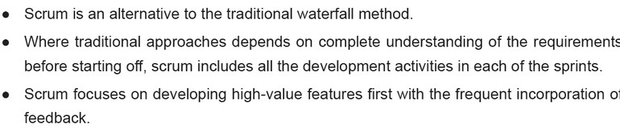
WHY SCRUM

Slide 9
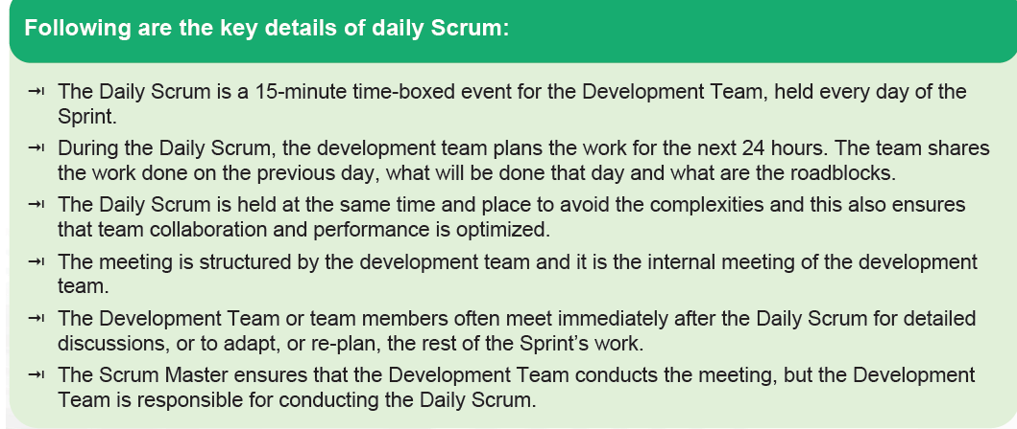
Daily Scrum

Slide 10
Transparency
Adaptation
Inspection
SCRUM THEORY

Slide 11
Transparancy
Ensures:
The important aspects of the processes related to any business are visible to those who are responsible for the outcome.
Aspects are defined using a common standard.
All the observers understand the aspects in the same way.
Definition of ‘Done’ is common for who do the work and those who evaluate the results.

Slide 12
Inspection
Ensures:
To detect variances that may affect the process.
Scrum users should inspect the Scrum artifacts and progress at frequent intervals.
Inspection doesn’t affect the actual workflow.
Suitably experienced inspectors
Carry out the inspection process to derive value out of it.

Slide 13
Adaptation
Ensures:
Inspector identifies that any deviation in any of the process aspects makes the product unacceptable.
Adjustments in that process should be made.
This adjustment should be done as soon as the defective process is identified, so that further deviations can be avoided.

Slide 14

Events in inspection and Adaptation
Sprint Planning
Daily Scrum
Sprint Review
Sprint Retrospective

Slide 15
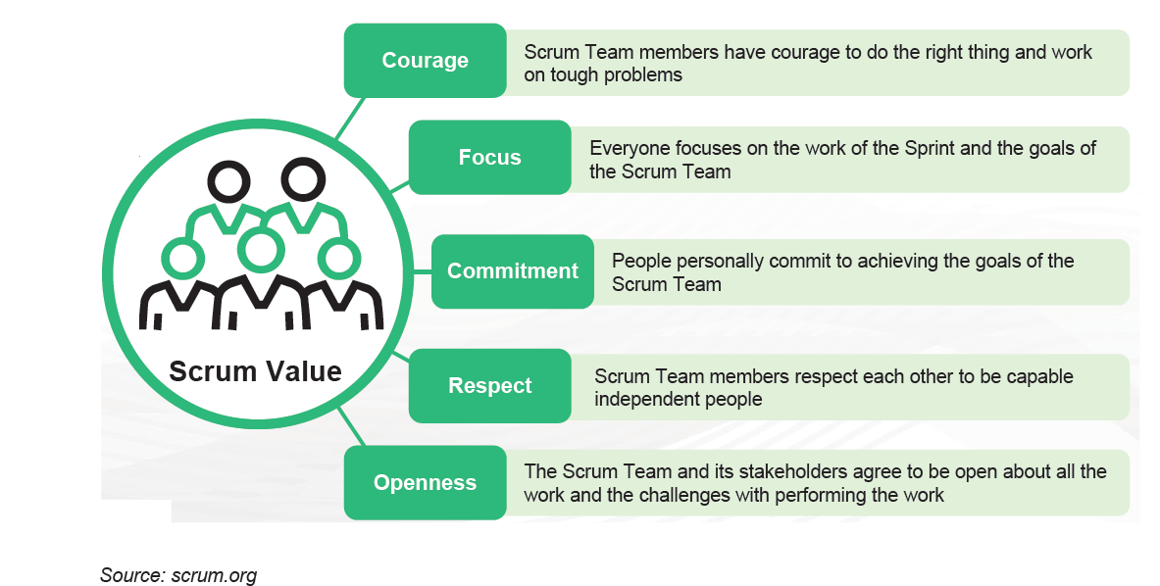
SCRUM VALUES

Slide 16
SCRUM VALUES
Commitment:
People should be committed to achieving the goals.
Courage:
The Scrum Team members have courage to do the right thing and work on tough
problems.
Focus:
Everyone focuses on the work of the Sprint and the goals of the Scrum Team.
Openness:
The Scrum Team and its stakeholders agree to be open about all the work and
the challenges with performing the work.
Respect:
Scrum Team members respect each other to be capable, independent people.

Slide 17
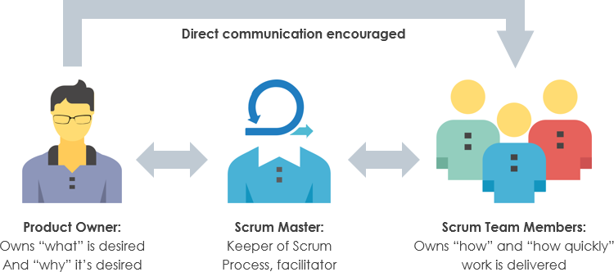
SCRUM ROLES

Slide 18



Product Owner
Scrum Master
Development
Team
Holder of Product
Servant Leader
Self organizing Group

Slide 19
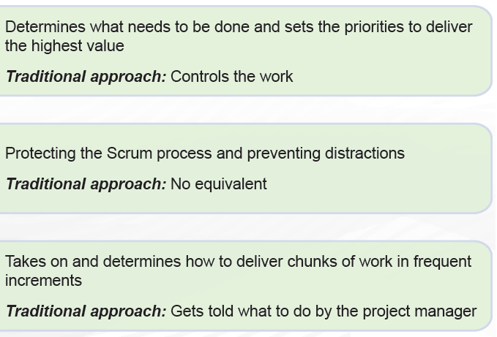
Product Owner
Scrum Master
Development Team

Slide 20
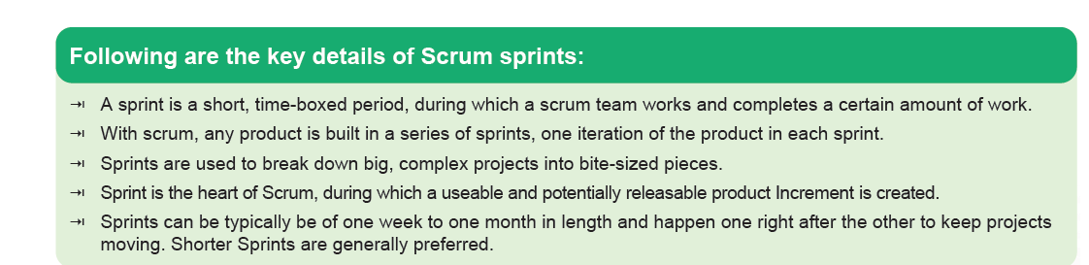
Sprints

Slide 21
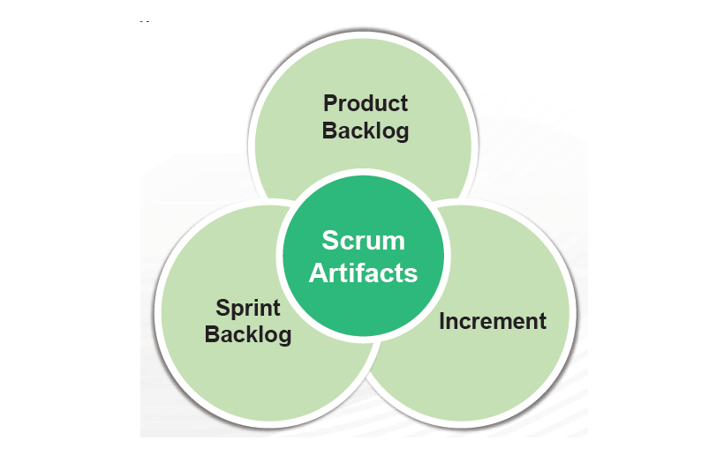
SCRUM ARTIFACTS

Slide 22
SCRUM ARTIFACTS
Product backlog is a list of the desired functionalities in the order of priority.
Sprint backlog is the set of PBIs selected for the Sprint, along with the plan to realize the Sprint goal.
Increment refers to the sum of all the product backlog items completed during a Sprint and the value of the increments of all the previous Sprints.

Slide 23
SCRUM EVENTS
Sprint Planning
Daily Scrum
Sprint Review
Sprint Retrospective

Slide 24
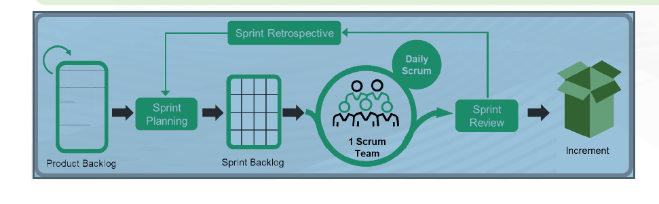
Sprints

Slide 25
SCRUM EVENTS
Sprint Planning
Sprint is planned and finalized. The Sprint
Goal is also finalized during the sprint planning meeting. This plan is devised collaboratively
by the Scrum Team.
The Daily Scrum
Conducted for the Development Team everyday of the Sprint.
Team shares the work done on the previous day
15-minute time-boxed event.
Development Team plans work for the next 24 hours.
Sprint Review:
The purpose of this meeting is to check the Increment and based on the feedback, to adapt the Product backlog
Sprint retrospective
The team inspects itself and creates a plan for improvements
that are to be implemented during the next Sprint.

Slide 26

QUERIES

